Slide 1
DEMO CODE
By - Ishav

Slide 2
Problem
Create a command-line shopping cart application. Your application should support adding items, removing items, and calculating the total price with possible discounts.
Use the Strategy pattern for the discount calculation and demonstrate how this pattern makes your application more flexible.

Slide 3
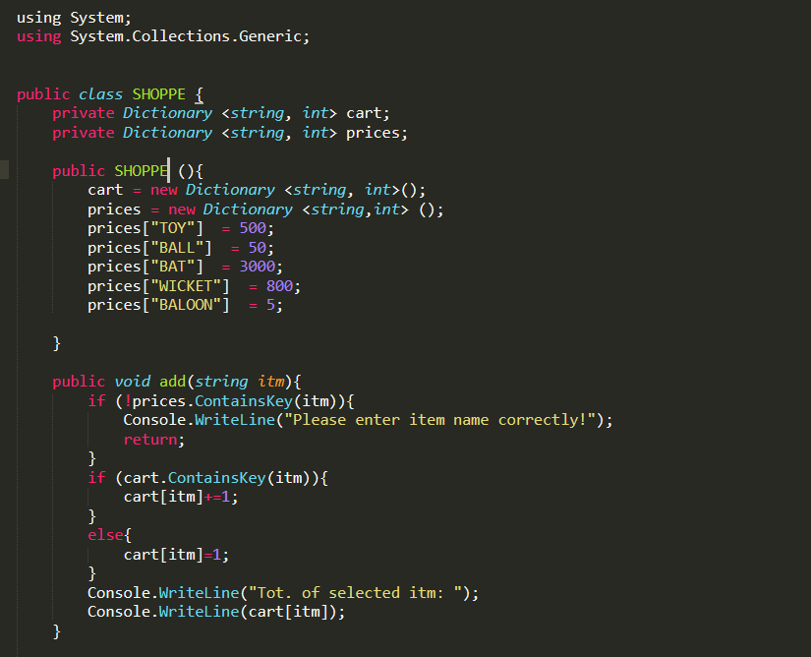
Solution

Slide 4
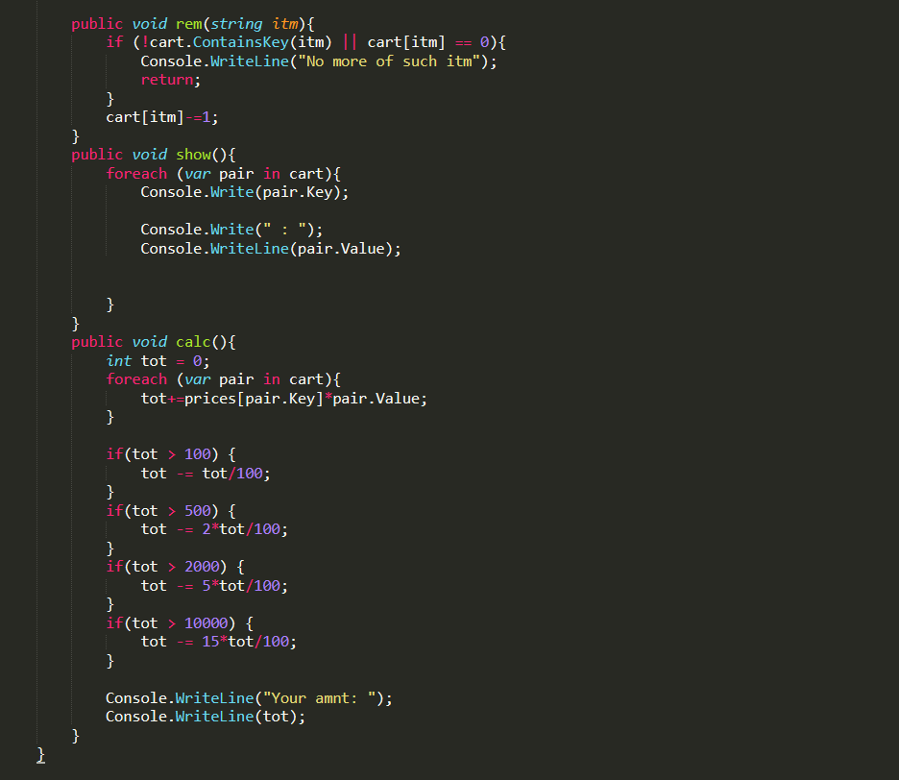

Slide 5
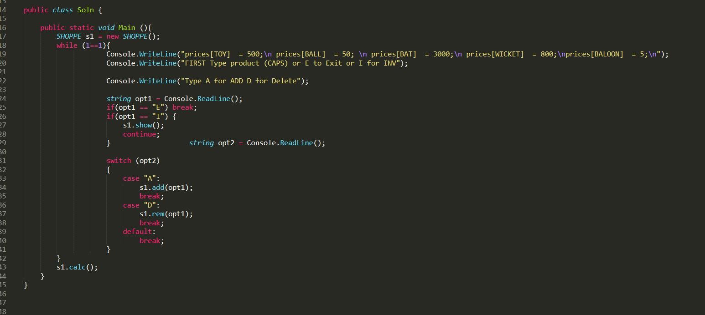

Slide 6
Complete Code & Output pushed to gitub
Link - https://github.com/IshavGG/practiceCsharp/blob/main/Program.cs

Slide 7
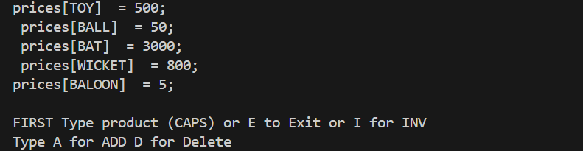


Input:
Output:

Slide 8


If wrong name is passed – (TOY A) is wrong name
You can also delete item and view inventory
After Typing E, Cart is processed and discounts (proportionate to purchase is applied

